Slide 1



Pay By Link
Setting Guideline

Slide 2
Procedure Of Pay By LINK
Step 2
Step 1
Create LINK
Step 4
Enter the Order
Merchant select the order, enter the amount to create a link.
Step 3
Login ODPM，enter the order information to the portal，create an order record.
Complete Payment
Send the LINK
Consumer receive the email, complete the payment at their mobile devices by URL/QR Code.
Copy the link URL/ QR Code and paste to email to consumer.

Slide 3
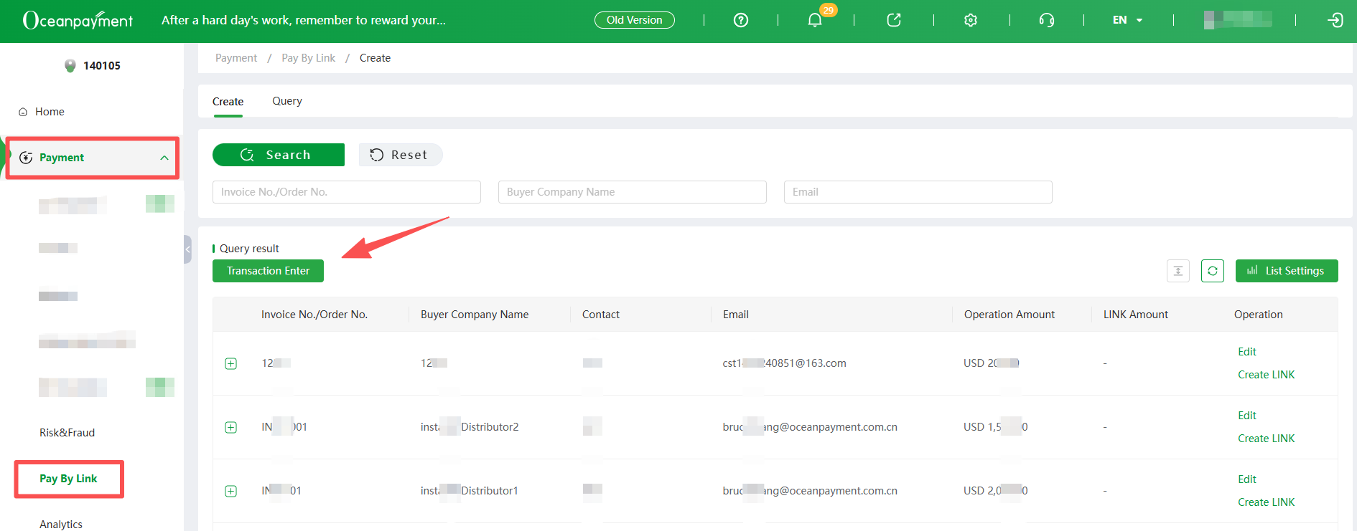
ODPM- Payment – Pay By Link- Create

Slide 4
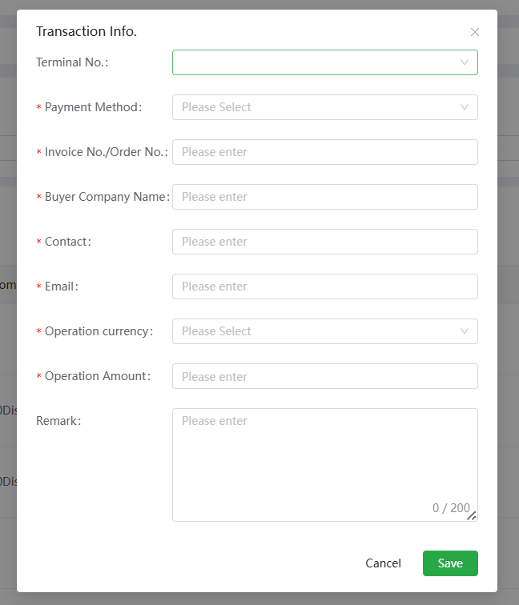
ODPM- Payment – Pay By Link- Create
Terminal Number | 终端号 (支付方式)
Payment Method | Will automatically display the payment method corresponding to the terminal number
Invoice No./Account Order No | Your order number to this order
Buyer Company Name | Can put “N/A”
Contact | Customer’s name
Email | The email address of customer
Operation Currency | Order Currency
Operation Amount | Order Amount
Remark | /

Slide 5
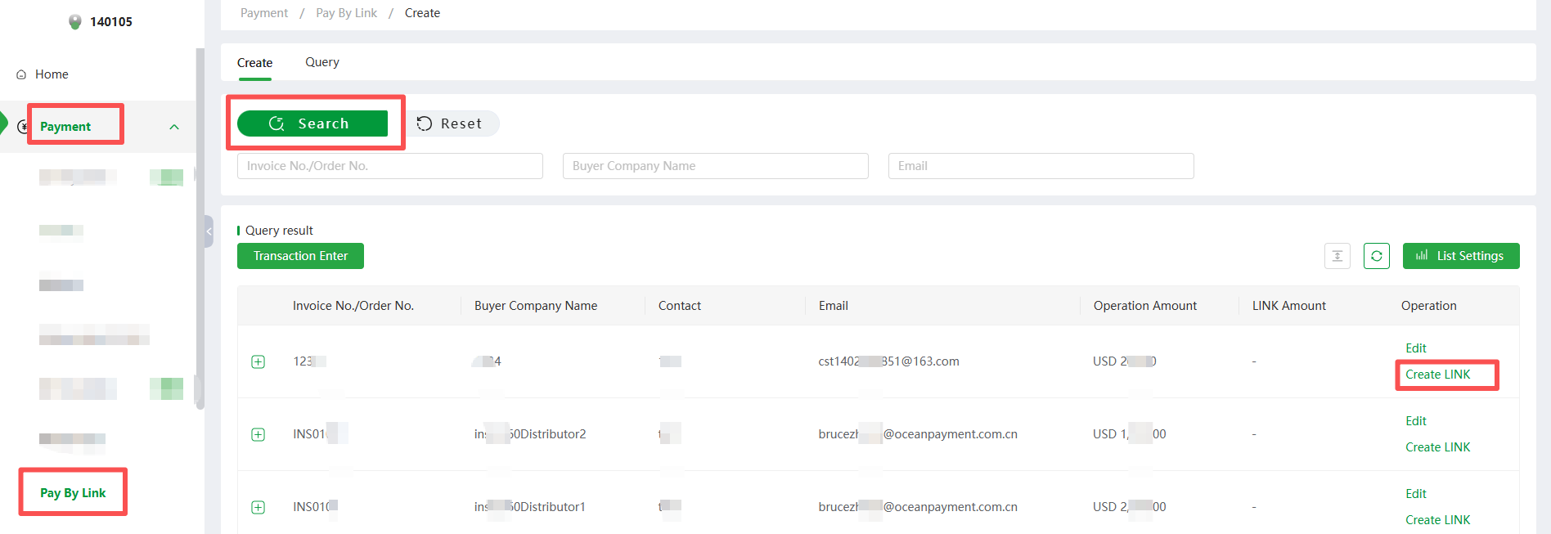
ODPM- Payment – Pay By Link- Create
After an order has been created, it can be found by clicking Search.
If the order needs to be modified, you can click Edit to modify it, or you can click Create Link to generate a link directly.

Slide 6
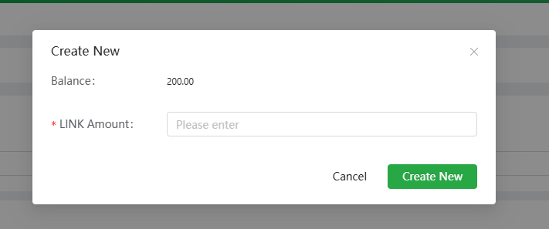
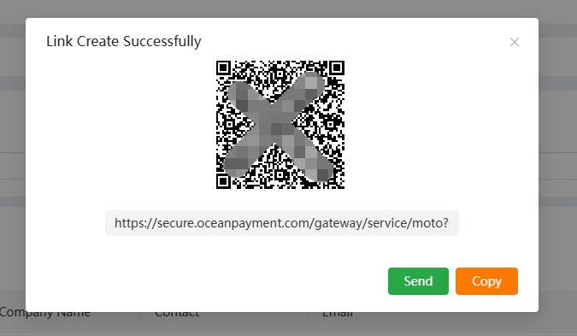

ODPM- Payment – Pay By Link- Create
1
2
1. Fill the full amount in the LINK Amount
2. Click the Create Now
3. Select the Copy to copy the payment URL and send it out to the customer by email
4. Partial payment cannot be generated more than 5 times
Copy the payment link to the Confirmation
Note: Please be noted that the payment link only valid within 48 hours, so after you create the link, please send it out to the consumer shortly.

Slide 7
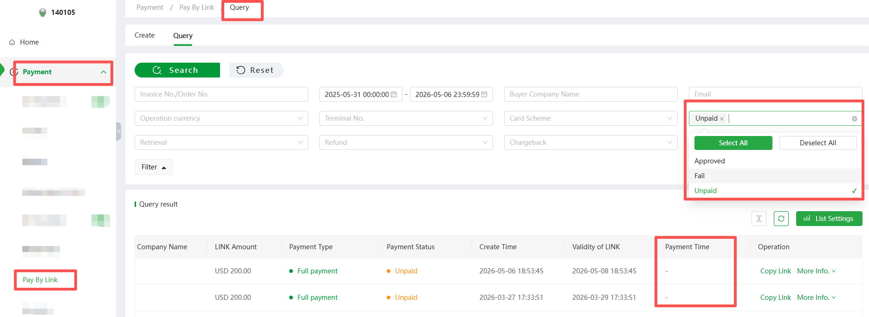
ODPM- Payment – Pay By Link- Query
Approved: Order paid
Unpaid: Order unpaid. If the order is not recorded the Payment Time, then the consumer has not yet opened
the link and the link is still valid
Fail: Order expired

Slide 8
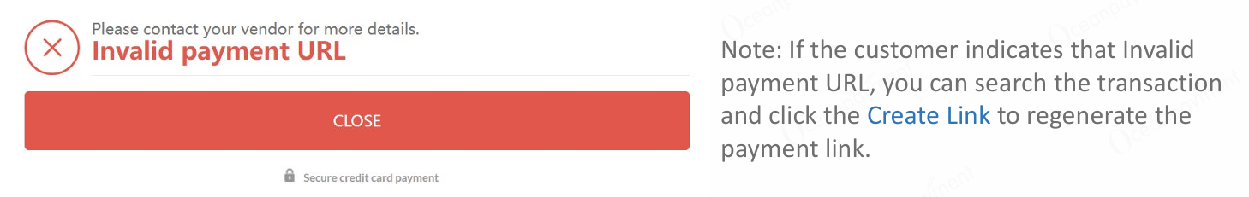
ODPM- Payment – Pay By Link- Query

Slide 9


